Slide 1

Relational databases
DATA ANALYTICS | IRONHACK

Slide 2

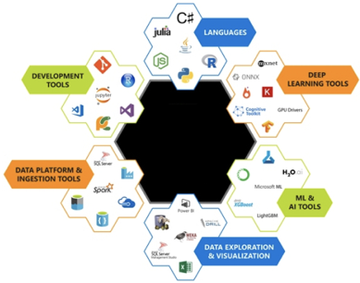
IRONHACK BOOTCAMP
Different Tools for different purposes
ETL:
Querying:
Visualization: (tableau)?
Machine Learning:

Slide 3



Relational
DATABASES
Non-relational
DATABASES

Slide 4
IRONHACK BOOTCAMP
Relational vs. Non-relational
Structured Data
Information stored in several related tables
Fixed scheme
SQL
Unstructured Data
Information stored in a single table
No fixed scheme
No SQL

Slide 5
Example of relational database
Date | Name | Country | Speciality
05/10/2020 | Joseph | US | Traumatology
23/09/2015 | Katia | AR | Ophthalmology
09/06/2016 | George | PO | Pediatrics
17/08/2018 | Linda | UK | Cardiology

Slide 6
Example of non relational database
[
{“date” : 05/10/2020, “name”: Joseph, “country”: US, “speciality”: traumatology},
{“date”: 23/09/2015, “name”: Katia, “country”: AR, “speciality”: ophthalmology},
{“date”: 09/06/2016, “name”: George, “country”: PO,”url”: www.georgepediatrics.com “speciality”: pediatrics},
{“date”: 17/08/2018, “name”: Linda, “speciality”: cardiology}
]

Slide 7
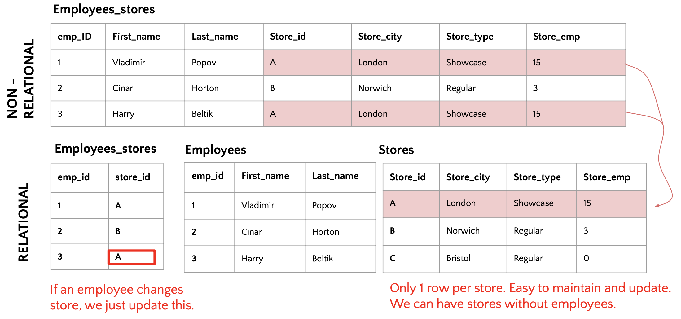
Relational databases saves disk space
ACID compliancy (Atomicity, Consistency, Isolation, Durability)
Normalization rules

Slide 8
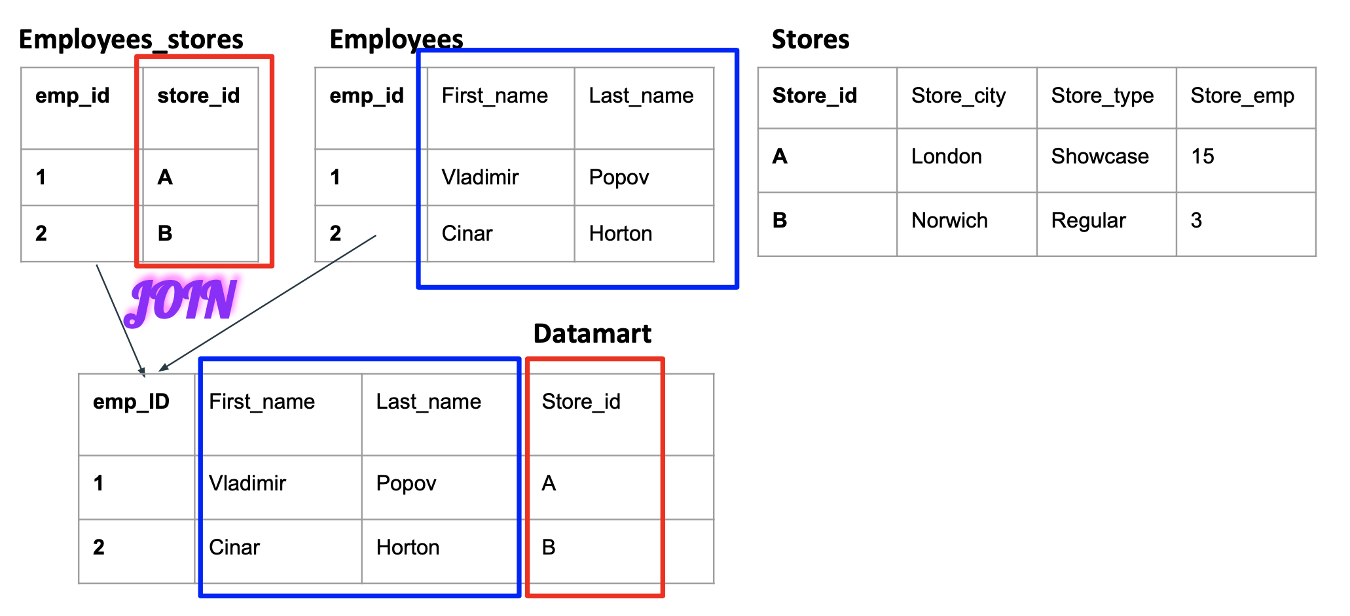
What if you need a full table for reporting?

Slide 9
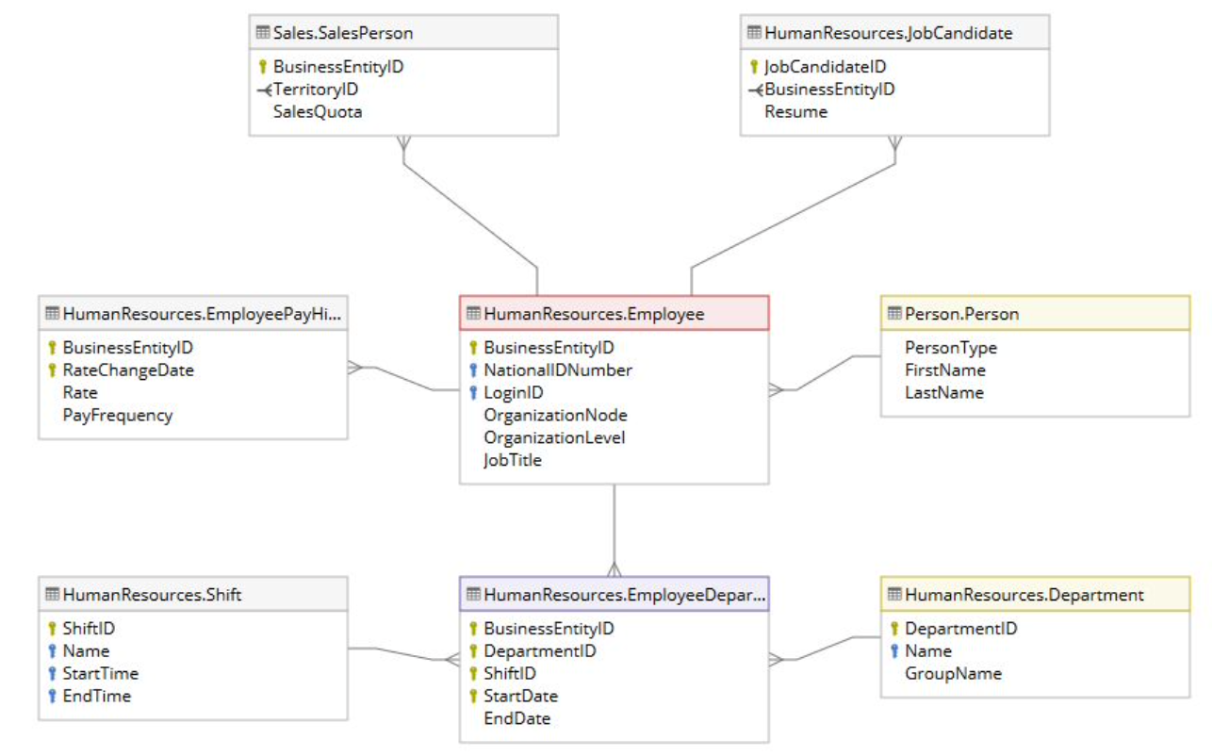
DataBase model (ERD)

Slide 10
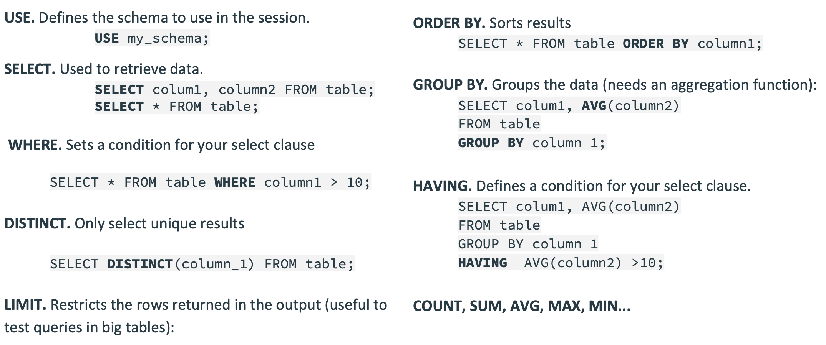
Basic SQL functions
SQL cheatsheet

Slide 11
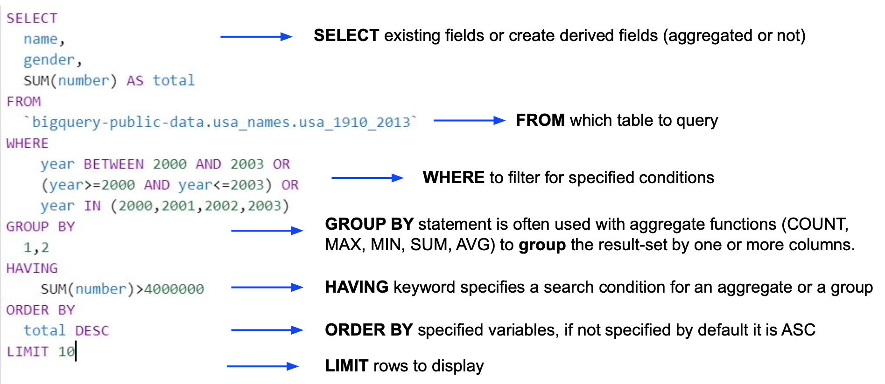
SQL query components

Slide 12
IRONHACK BOOTCAMP
ARITHMETIC OPERATORS | +, - , *, /, %,
Those operators can be used within the SELECT statement:
SELECT *, amount - payments AS balance FROM bank.loan;
SELECT loan_id, account_id, duration, status, (amount - payments)/1000 AS ‘Balance in thousands’ FROM bank.loan;
SELECT duration%2 FROM bank.loan;
SELECT 10%3;

Slide 13
IRONHACK BOOTCAMP
LOGICAL OPERATORS | AND, OR
You can use logical operators in a WHERE clausule:
SELECT * FROM bank.loan
WHERE status NOT IN (‘B’,’b’) AND amount > 100000;
SELECT * FROM bank.loan
WHERE amount > 100000 AND amount < 200000;
SELECT distinct A2 FROM bank.district
WHERE A2 IN (‘Benesov’,’Beroun’) OR A4 < 75000
LIMIT 10;

Slide 14
IRONHACK BOOTCAMP
COMPARISON OPERATORS | <, >, >=, <=, <>
You can use logical operators in a WHERE clausule:
SELECT * FROM bank.loan
WHERE status NOT IN (‘B’,’b’) AND amount <> 100000;
SELECT * FROM bank.loan
WHERE amount > 100000 AND amount <= 200000;
SELECT distinct A2 FROM bank.district
WHERE A2 IN (‘Benesov’,’Beroun’) OR A4 < 75000
LIMIT 10;

Slide 15
IRONHACK BOOTCAMP
DISTINCT
This command allow us to get the unique values from a columns as “unique()” function from Pandas.
SELECT DISTINCT A3 FROM bank.district;

Slide 16
IRONHACK BOOTCAMP
IN
This command allow us to check for multiple values in a “list”
SELECT * FROM bank.account
WHERE district_id IN (1,2,3,4,5);

Slide 17
IRONHACK BOOTCAMP
WHAT IS AGGREGATION?
Is the process of computing something for a given column (ie)
By gender
By Age

Slide 18
IRONHACK BOOTCAMP
AGGREGATION FUNCTIONS AVAILABLE
The functions available are:
sum()
min()
max()
avg()
count()

Slide 19
IRONHACK BOOTCAMP
AGGREGATING VALUES
To compute aggregated values by group the syntax is:
SELECT function(column) FROM db.table
GROUP BY column;
select avg(amount) from bank.loan
group by status;
select avg(amount) as Average, status from bank.loan
group by status
order by Average asc;

Slide 20
IRONHACK BOOTCAMP
SORTING | ORDER BY
To sort the output, you can use ORDER BY col, which by default sorts in ascending order
SELECT distinct A2 FROM bank.district
WHERE A2 IN (‘Benesov’,’Beroun’) OR A4 < 75000
ORDER BY A4
LIMIT 10;
Default ordering can be changed appending DESC;
SELECT distinct A2 FROM bank.district
WHERE A2 IN (‘Benesov’,’Beroun’) OR A4 < 75000
ORDER BY A4 DESC
LIMIT 10;

Slide 21
IRONHACK BOOTCAMP
SORTING OUTPUT | ORDER BY
To sort the output, you can use ORDER BY col, which by default sorts in ascending order
SELECT distinct A2 FROM bank.district
WHERE A2 IN (‘Benesov’,’Beroun’) OR A4 < 75000
ORDER BY A4
LIMIT 10;
Default ordering can be changed appending DESC;
SELECT distinct A2 FROM bank.district
WHERE A2 IN (‘Benesov’,’Beroun’) OR A4 < 75000
ORDER BY A4 DESC
LIMIT 10;

Slide 22
IRONHACK BOOTCAMP
NUMERIC FUNCTIONS | COUNT(), MIN(), MAX(), AGV(), FLOOR(), CEILING()
The usage of those functions is within SELECT or WHERE:
SELECT max(amount) AS max, min(amount) AS min FROM bank.order;
SELECT floor(avg(amount)) FROM bank.order;
SELECT ceiling(avg(amount)) FROM bank.order;
There are other numeric functions as:
acos(), asin(), power(), log(),....

Slide 23
IRONHACK BOOTCAMP
STRING FUNCTIONS | LENGTH(), CONCAT(), FORMAT(), LOWER(), UPPER(),
Some usage examples:
SELECT *, LENGTH(k_symbol) AS ‘symbol_length’ FROM bank.order;
SELECT *, CONCAT(order_id, account_id) AS ‘concat’ FROM bank.order;
SELECT FORMAT(amount, 2) FROM bank.loan;
SELECT *, LOWER(A2), UPPER(A3) FROM bank.district;
SELECT *, LEFT(A2, 2), A3, LTRIM(A3) FROM bank.card;

Slide 24
IRONHACK BOOTCAMP
STRING FUNCTIONS | LEFT(), XTRIM() SUBSTRING_INDEX()
The function LEFT(col,n), returns the first “n” characters from a string from left:
SELECT *, LEFT(A2, 2), A3, FROM bank.card;
The function XTRIM(col), where “X” can be “L”, “R”, “” remove any blank spaces from a string (starting from left, right,...)
SELECT *, LTRIM(A3), FROM bank.card;

Slide 25
IRONHACK BOOTCAMP
STRING FUNCTIONS | SUBSTRING(), SUBSTRING_INDEX()
The function SUBSTRING(string, n, m) returns the “m” firsts characters from a string starting from the “n-th” position.
SELECT SUBSTRING(‘Hello world’,7,1) -> ‘w’
The function SUBSTRING_INDEX(string, delimiter, times)
SELECT SUBSTRING_INDEX(“www.google.com”, “.”, 2) -> “www.google”

Slide 26
IRONHACK BOOTCAMP
LIKE
This command allows to search for column values which have a “pattern” called “mask”.
It has two “wildcards”:
% -> zero, one or multiples characters
_ -> single character
SELECT * FROM bank.district
WHERE A3 LIKE ‘north%’;
SELECT * FROM bank.district
WHERE A3 LIKE ‘north_M%’;

Slide 27
IRONHACK BOOTCAMP
REGEXP (ReGularExpressions)
This term encapsulates a whole set of wildcards in order to look for patterns in strings.
The way to look for regular expressions is typing “regexp” and pattern you are looking for. Some “regex” popular patterns are:
‘^’ -> beginning of the string
‘$’ -> end of the string
‘|’ -> OR
SELECT * FROM bank.district WHERE A2 regexp '^B';
SELECT * FROM bank.district WHERE A2 regexp 'ov$';
SELECT distinct k_symbol FROM bank.order WHERE k_symbol regexp ‘ip|is’

Slide 28
IRONHACK BOOTCAMP
MORE STRING FUNCTIONS
More string functions can be found at:
https://www.w3resource.com/slides/mysql-string-functions.php

Slide 29
IRONHACK BOOTCAMP
WHERE CLAUSE
As you know, this clause has to be used before the aggregation with GROUP BY
select type, operation, k_symbol, round(avg(balance),2) as Average
from bank.trans
where k_symbol <> '' and k_symbol <> ' ' and operation <> ''
group by type, operation, k_symbol

Slide 30
IRONHACK BOOTCAMP
HAVING | What? Why?
HAVING clause is equivalent to WHERE BUT to check conditions AFTER GROUP BY.
select type, operation, k_symbol, round(avg(balance),2) as Average
from bank.trans
where k_symbol <> '' and k_symbol <> ' ' and operation <> ''
group by type, operation, k_symbol
having Average > 30000
order by type, operation, k_symbol;

Slide 31
IRONHACK BOOTCAMP
HAVING | What? Why?
HAVING clause is equivalent to WHERE BUT to check conditions AFTER GROUP BY.
select type, operation, k_symbol, round(avg(balance),2) as Average
from bank.trans
where k_symbol <> '' and k_symbol <> ' ' and operation <> ''
group by type, operation, k_symbol
having Average > 30000
order by type, operation, k_symbol;
select round(avg(amount),2) - round(avg(payments),2) as Avg_Balance, status, duration
from bank.loan
group by status, duration
having Avg_Balance > 100000
order by duration, status;

Slide 32


